Slide 1
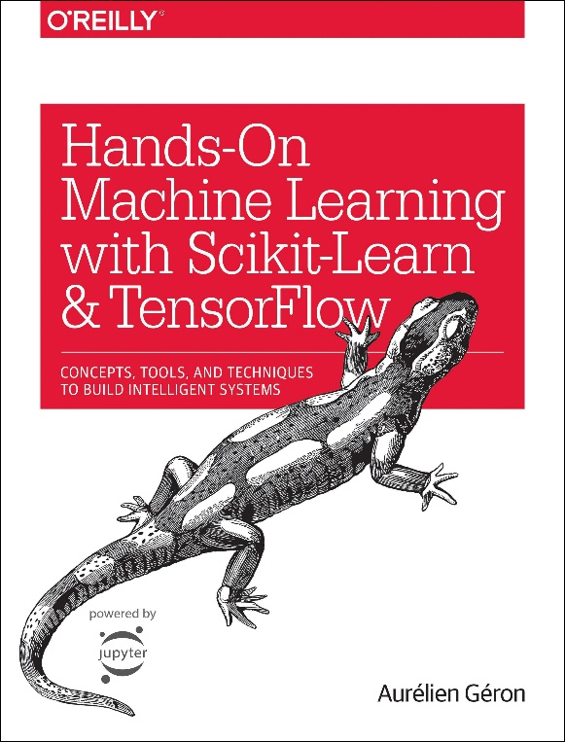

Novice Machine Learning E2E Project
Part 08
Categorical attribute & One Hot Encoding
Mukunthan Ragavan

Slide 2
E2E Machine Learning Project
Look at the Big picture.
Get the Data (Split the Data, Stratifying the Data).
Discover and visualize the data to get insights.
(Scatter with plot with density and color map, Correlation)
Prepare the data for ML algorithms. (Data Cleaning, One Hot Encoding)
Select a model to train it.
Fine-tune your model.
Present your solution.
Launch, monitor and maintain your system.

Slide 3
ML algorithms could not understand text values, so we need to label, each unique text value with integer. Then, we know that these integers does not mean any value, just label. Ex. 5 is not greater than in 1 in case of labels. So, we need to do One Hot Encoding. If 3 unique labels, then create 3 binary fields out of which one will have 1 and rest will have zeros.

Slide 4
Coding in action !

Slide 5
Thanks All for watching and your subscription !

